Slide 1
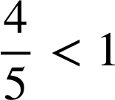

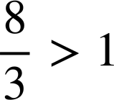
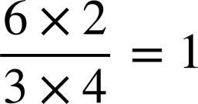


Checking and securing converting improper fractions to mixed numbers
Task A: Proper and improper fractions
Insert the inequalities = ,﹥and﹤to make the statement true
a)
c)
b)
d)
2) Identify if the following are true or false
Statement | True | False
The value of a proper fraction is always less than 1
The value of an improper fraction is always greater than 1
A fraction in the form a/b where a>b is an improper fraction
789 ÷ 788 will give a number greater than 1
It can equal 1
3) Without calculating the answer,
which letter corresponds to the calculation
5677 ÷ 5678 is letter D
5678 ÷ 5678 is letter A
5679 ÷ 5678 is letter C
5678 ÷ 2880 is letter B

Slide 2
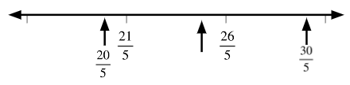
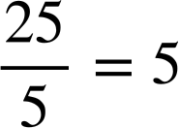
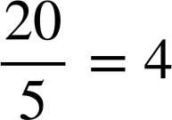
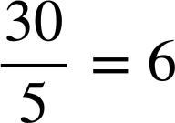
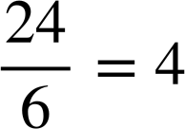
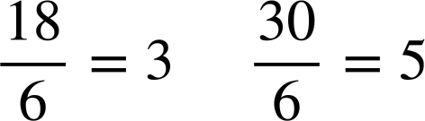
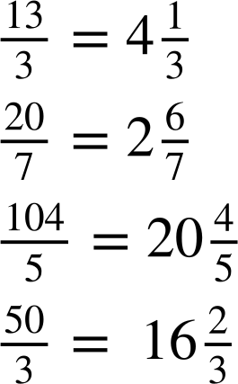
Checking and securing converting improper fractions to mixed numbers
4) Here is a section of a number line
Which whole number is the arrow pointing to?
Approximately mark another two whole numbers on the number line. What are these whole numbers?
How would your answers change if the denominator was 6?
What could the denominator be if there were no whole numbers between the two fractions?
The answer for part a) would be
The answers for part b) would be and
Any integer which does not have one of its multiples between 21 and 26.
E.g. It could be 7 because the first fraction would be a whole number but there are no more before the second fraction.
E.g. It couldn’t be 8 as 24 is a multiple of 8, so 3 would lie between the two fractions.
E.g. It could be 9 because there are no multiples of 9 between 21 and 26.
2 is before the first fraction and 3 is after the second fraction.
Task B: Changing improper fractions to mixed numbers
1) Write the mixed number of the following improper fractions.
a)
b)
c)
d)

Slide 3
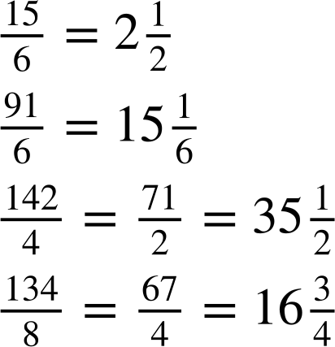
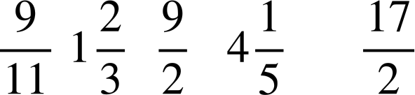


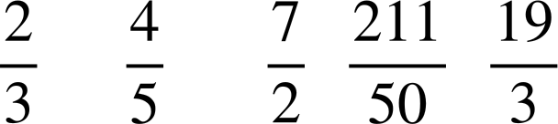


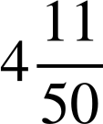
Checking and securing converting improper fractions to mixed numbers
2) Fill in the blanks.
a)
b)
c)
d)
3) Put the following numbers in ascending order, smallest to largest. Converting to a mixed number may help.
a)
b)
Mathematics in Education and Industry
v2.2

